Slide 1


Shadowing a florist
Discover the captivating world of floristry through a firsthand job shadowing experience.

Slide 2

Introduction
What is job shadowing?
Why choose floristry?
What this presentation covers
A learning opportunity to observe and gain hands-on experience.
To understand the art and business of floral design.
My observations, key learnings, and next steps.

Slide 3




What is Job Shadowing?
An opportunity to learn from professionals in their field.
Gain insights into daily tasks and challenges.
Provides valuable experience for career exploration.

Slide 4





Why Shadow a Florist?
Learn about floral design and arrangement techniques.
Understand customer interactions and business management.
Experience event planning and seasonal trends.
See the physical and creative demands of the profession.

Slide 5
The Job Shadowing Process
Research the role of a florist.
Identify your goals for the job shadowing.
Prepare for the experience, including contacting a florist and scheduling a visit.
Observe, ask questions, and assist when possible.
Follow up with the florist and reflect on your learning.

Slide 6

Observations & Key Learnings
1
Daily routine of arranging flowers, handling customers, and managing inventory.
2
Importance of creativity, organization, and business skills.
3
Challenges of perishable products, peak seasons, and client expectations.
4
Work environment and teamwork within a floral shop.

Slide 7

Skills Needed to be a Florist
Creativity
Artistic vision for floral arrangements.
Communication
Customer service and effective communication skills.
Knowledge
Understanding of flowers, plant care, and seasonal trends.
Management
Time management, multitasking, and business skills for pricing and inventory control.

Slide 8





Sample Questions Asked
What inspired you to become a florist?
What are the most rewarding and challenging parts of your job?
What skills are essential for success in floristry?
How do you handle seasonal demand and event planning?
What advice would you give to an aspiring florist?

Slide 9



Reflection & Future Steps
1
How this experience has influenced my career interest.
2
Consider taking floral design courses or internships.
3
Explore opportunities in event floristry, retail, or online floral businesses.

Slide 10
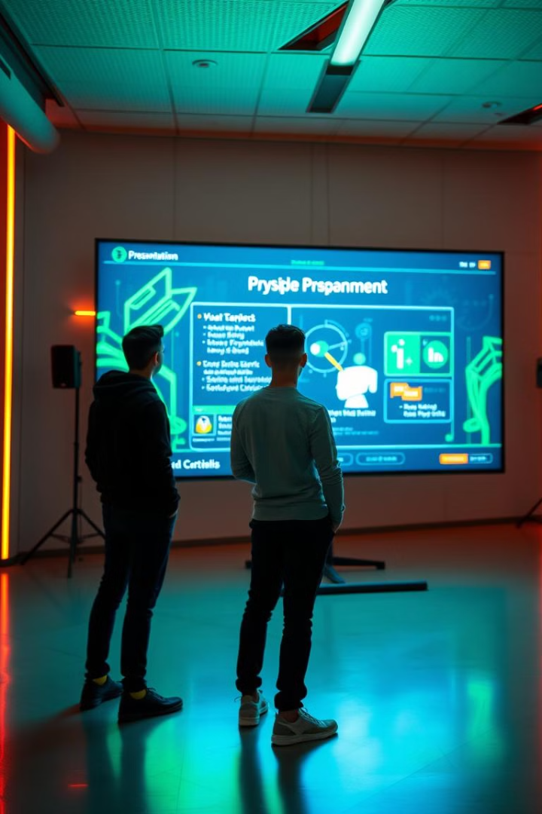
Conclusion & Q&A
Job shadowing offered invaluable insights into the world of floristry. It provided an understanding of the daily tasks, skills required, and challenges faced by professionals. The experience sparked a strong interest in exploring this field further.
https://drive.google.com/file/d/1Xj6o73pzTIwf56-DfAB4PfDLJwKd_Q9x/view?usp=sharing

